Slide 1
Data Mining
BY
Adnan Amin

Slide 2
Topic
Decision Tree

Slide 3
Decision Tree Induction
The learning of decision trees from class-labeled training tuples, known as decision tree induction.
Decision tree is a flowchart like tree structure, where each internal node denotes a test on an attribute, branch represents an outcome of the test, and each terminal node holds a class label.
Internal node: non-leaf node is an attribute
Branch: outcome of the test
Terminal node: leaf node
Root node: the topmost node in a tree.

Slide 4
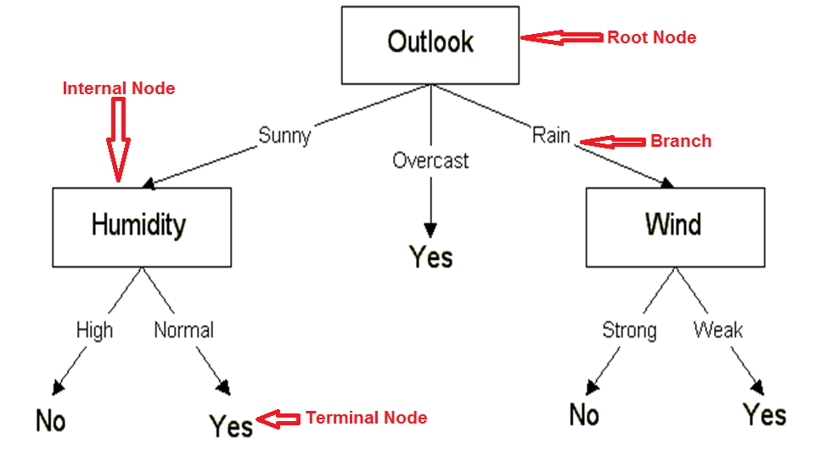
Example of Decision Tree

Slide 5
Denotation of Nodes
Internal Node (non-leaf node)
Denoted by rectangle
Root node
Denoted by rectangle but have not any parent
Branch
Denoted by linked-line between nodes with label
Terminal node (leaf node)
Denoted by ovals

Slide 6
Background
Decision Tree
Developed by J. Ross Quinlan (ML researcher).
During the late 1970s and early 1980s.
Decision tree algorithm known as ID3.
ID3 stands for Iterative Dichotomiser ( French word).
Dichotomiser: To separate into parts.
Supervised learning algorithms.
In 1984, Breiman, Friedman, Olshen and Stone published a book “Classification and Regression Trees (CART).
Ross Quinlan developed C4.5 (Statistical classifier) in 1993, the extension of ID3.

Slide 7
ID3, C4.5 and CART
All are on greedy approach, i.e., non-backtracking
In which decision trees are constructed in a top-down recursive divide-and-conquer manner.
Starts with a training set of tuples and their associated class labels. The training set is recursively partitioned into smaller subsets as the tree is built.

Slide 8
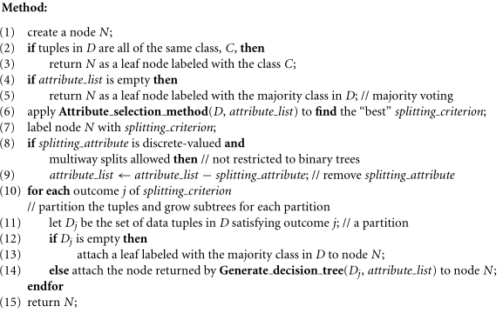
Decision Tree Algorithm cont.

Slide 9
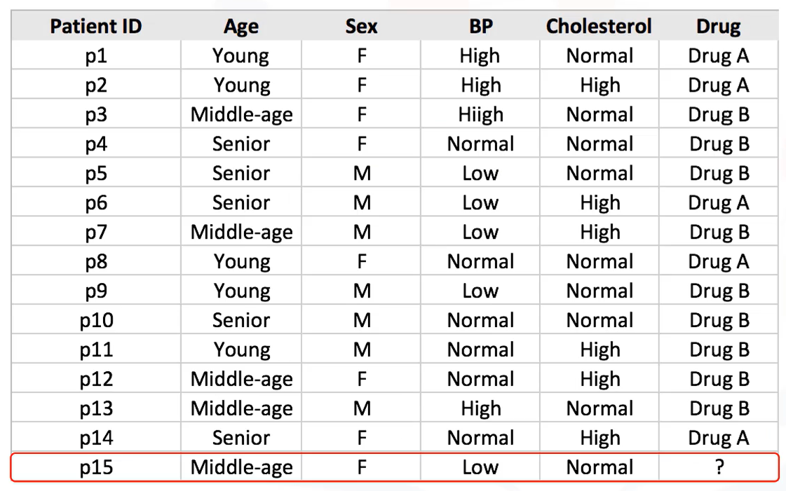
Understand the classification problem
Gender
Decision Tree induction
Notes:
Entropy = -p(A)log(p(A)) – p(B)log(p(B))

Slide 10
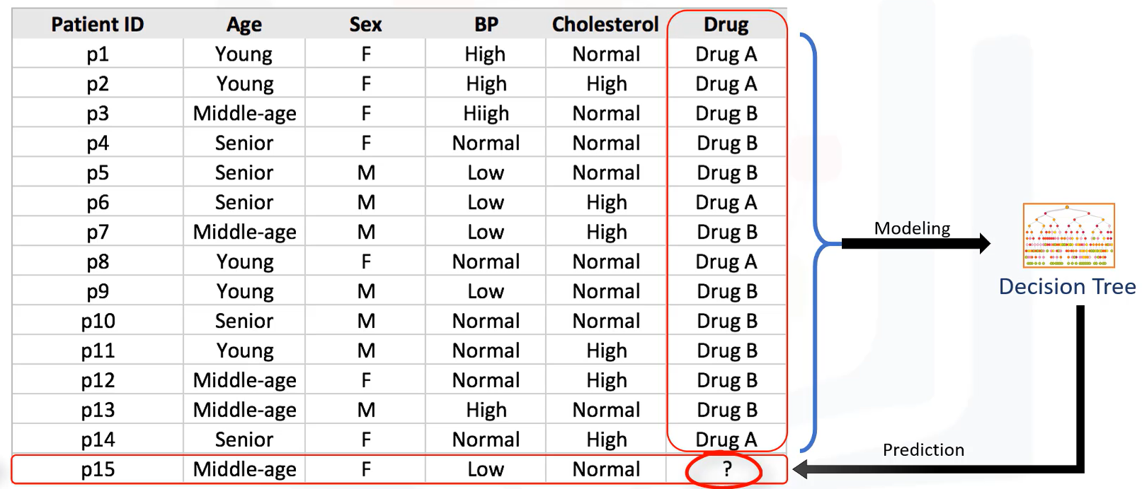
Understanding Decision Tree
Gender

Slide 11
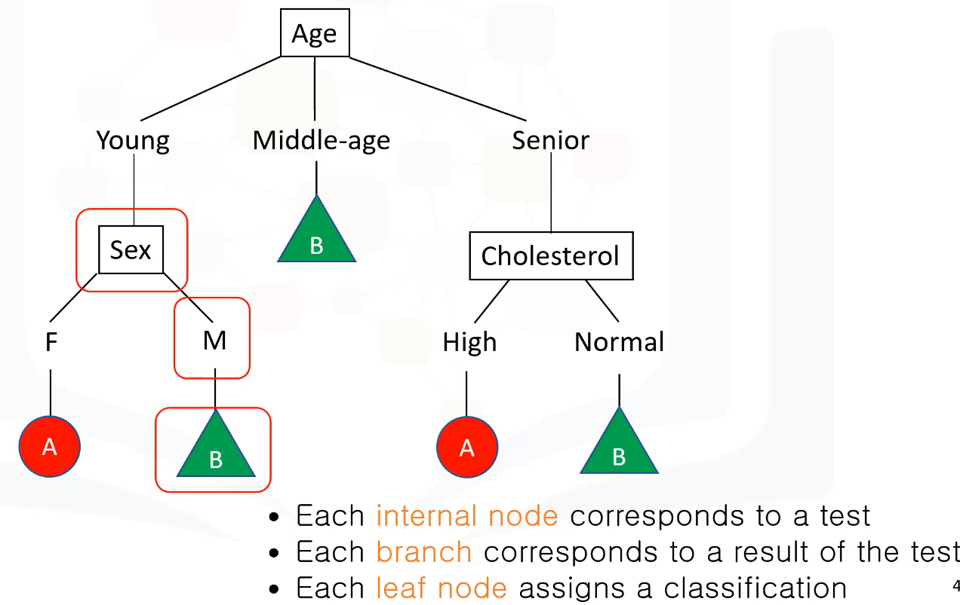
Gender

Slide 12
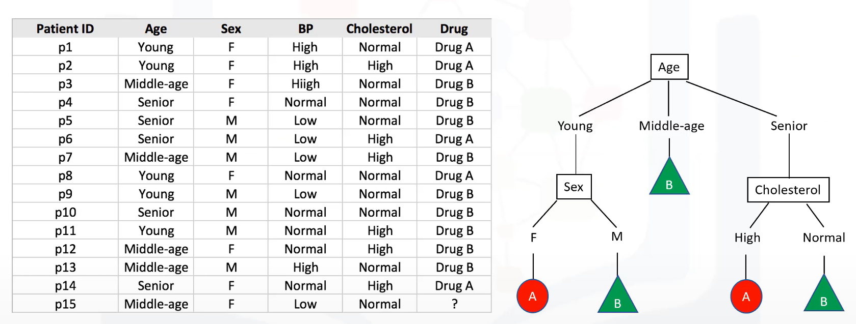
Building Decision Tree
Gender
Gender

Slide 13
Building Decision Tree
Understand the Entropy
The amount of disorder or randomness or uncertainty
Entropy = -p(A)log(p(A)) – p(B)log(p(B))
Remember:
The lower the entropy, the less uniform the distribution, and the purer the node.
If the sample/node is completely homogeneous then entropy will be Zero.
If the sample/node is equally divided, then the entropy will be 1

Slide 14
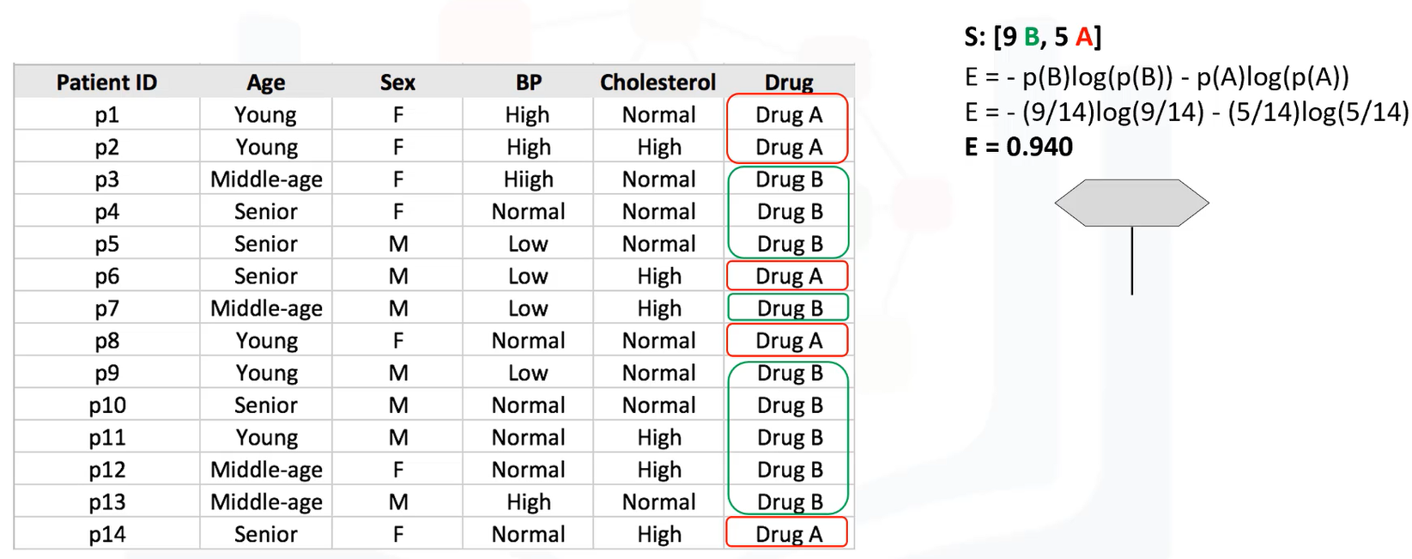
Calculate the Entropy
Gender

Slide 15
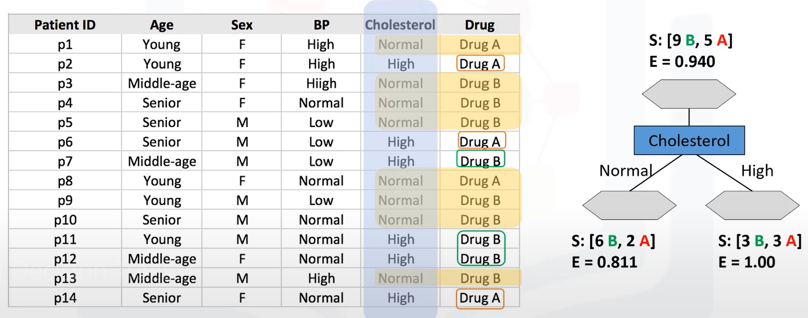
Gender

Slide 16
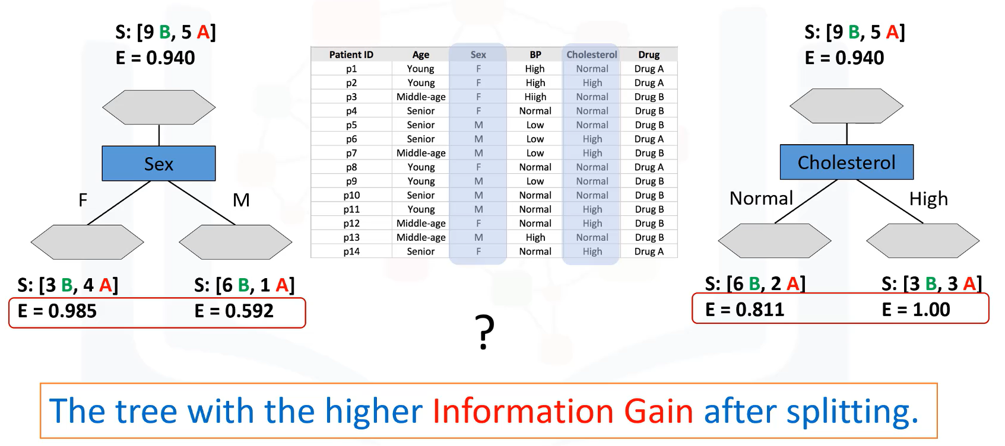
Which Attribute to Select for Node?
Gender

Slide 17
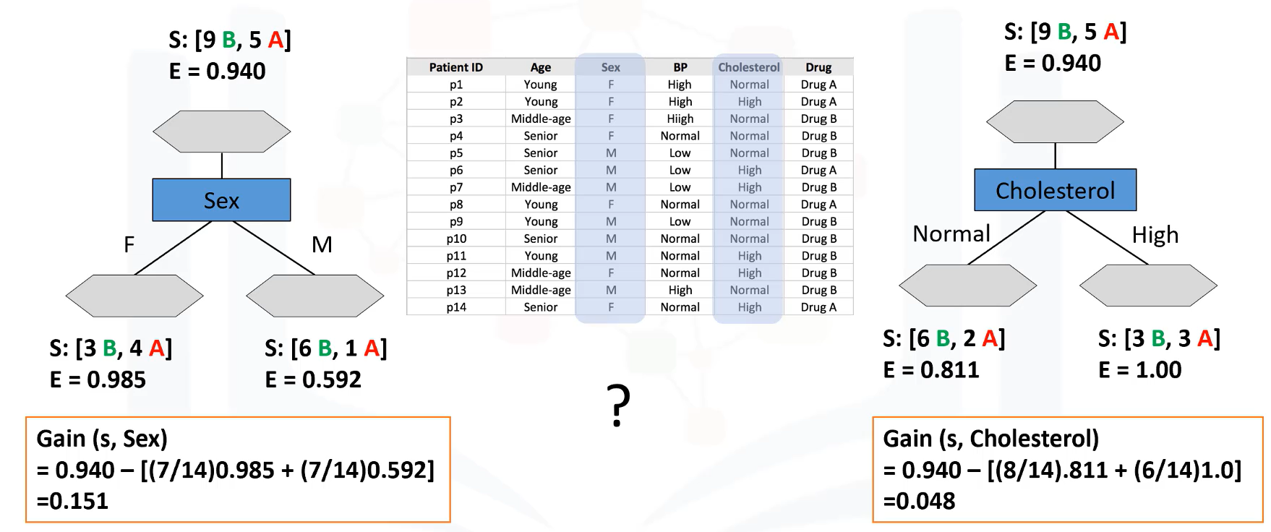

Slide 18
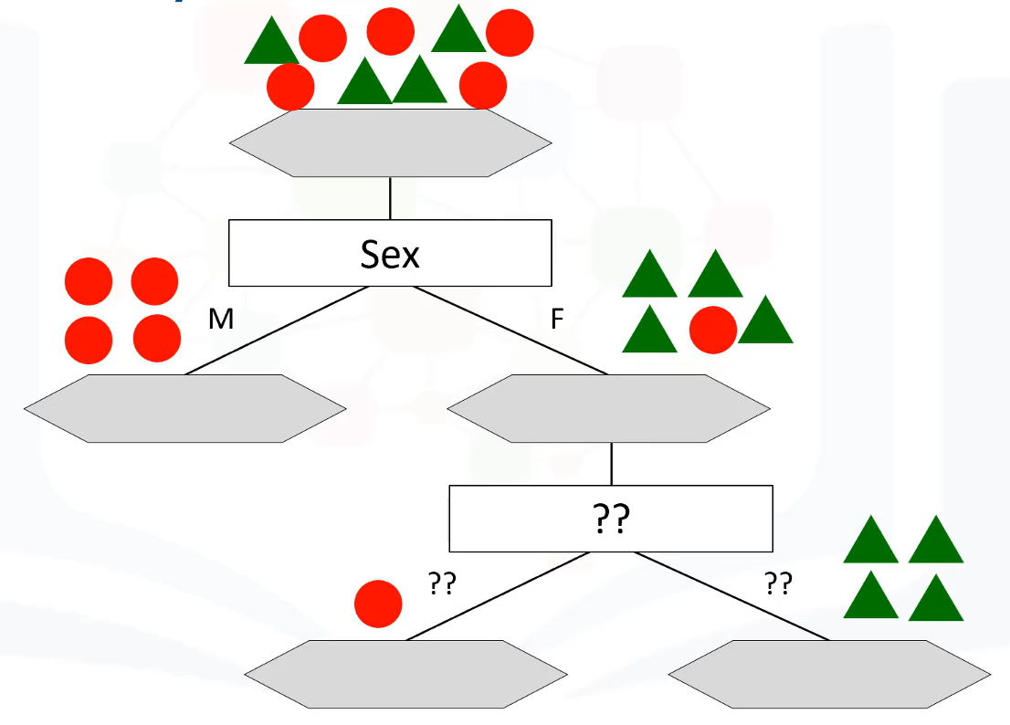

Slide 19
The basic strategy of decision tree
Understand the three parameters
D
It is refer to data partition. Initial, it is the complete set of training tuples and their associated class labels.
Attribute_list
List of attributes available in the dataset.
Attribute_selection_method
A heuristic procedure for selecting the attribute that “best” discriminates the given tuples according to class.
Utilizes info gain, gini index for attribute selection measures. (to be discussed later)

Slide 20
Decision Tree Algorithm
Algorithm: Generate decision tree. Generate a decision tree from the training tuples of data partition, D.
Input:
Data partition, D,
Attribute list,
Attribute selection method,
Output:
A decision tree
Method ?

Slide 21
Decision Tree Algorithm cont.
Step 1: create a node N;
The tree starts as a single node, N, representing the training tuples in D.

Slide 22
Decision Tree Algorithm cont.
Step 2 and 3
(2) if tuples in D are all of the same class, C, then
(3) return N as a leaf node labeled with the class C;
If the tuples in D are all of the same class, then node N becomes a leaf and is labeled with that class.
Step 4 and 5
(4) if attribute list is empty then
(5) return N as a leaf node labeled with the majority class in D; // majority voting
These steps 4 and 5 are terminating conditions.
Otherwise, the algorithm calls Attribute_selection_method to determine the splitting criterion. (step 6)

Slide 23
Decision Tree Algorithm cont.
Step 6
(6) apply Attribute selection method(D, attribute list) to find the “best” splitting criterion;
The splitting criterion tells us which attribute to test at node N by determining the “best” way to separate or partition the tuples in D into individual classes.
The splitting criterion also tells us which branches to grow from node N with respect to the outcomes of the chosen test.

Slide 24
Decision Tree Algorithm cont.
Step 7
(7) label node N with splitting criterion;
The node N is labeled with the splitting criterion, which serves as a test at the node.
Step 10 and 11
(10) for each outcome j of splitting criterio
(11) let D j be the set of data tuples in D satisfying outcome j;
A branch is grown from node N for each of the outcomes of the splitting criterion.
The tuples in D are partitioned accordingly (step 10 to 11). There are three possible scenarios.

Slide 25
Decision Tree Algorithm cont.
Three possible scenarios:
Let A be the splitting attribute. A has v distinct values, {a1, a2,……av}
A is discrete-valued
If A is discrete-valued, then one branch is grown for each known value of A.
Continuous-valued
If A is continuous-valued, then two branches are grown, corresponding to A ≤ split point and A > split point.
Discrete-valued and a binary tree
If A is discrete-valued and a binary tree must be produced, then the test is of the form A ∈ S A , where S A is the splitting subset for A.

Slide 26
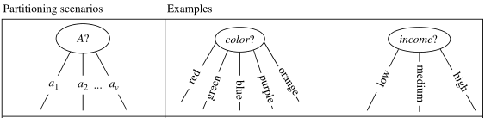
Three possible scenarios:
A is discrete-valued (Step 8 and 9)
If A is discrete-valued, then one branch is grown for each known value of A.

Slide 27
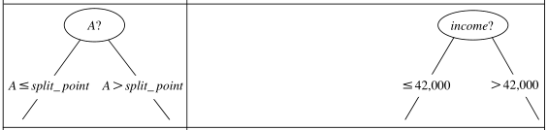
Three possible scenarios:
Continuous-valued
If A is continuous-valued, then two branches are grown, corresponding to A ≤ split point and A > split point.

Slide 28
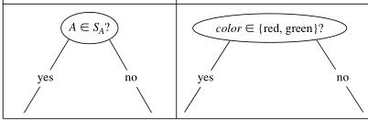
Three possible scenarios:
Discrete-valued and a binary tree
If A is discrete-valued and a binary tree must be produced, then the test is of the form A ∈ SA , where S A is the splitting subset for A.

Slide 29
Decision Tree Algorithm end.
Step 14
The algorithm uses the same process recursively to form a decision tree for the tuples at each resulting partition Dj of D.
The recursive partitioning stops only when any one of the following terminating condition is true.
Step 2 and 3 (all tuples in partition D belong the same class).
Step 4 (no remaining attribute on which the tuples may be further partitioned).
Step 12 (no tuples for a given branch i.e., partition Dj is empty).
The resulting decision tree is returned.

Slide 30
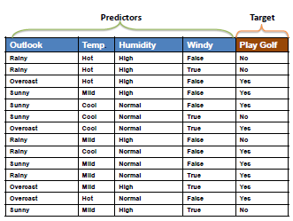
Step by Step Construction of Decision Tree

Slide 31
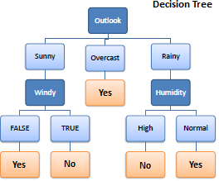
The desired Decision Tree

Slide 32
ID3 (the core algorithm by J.R. Quinlan)
ID3 uses Entropy and Information Gain to construct a decision tree.
Entropy
A decision tree is built top-down form a root node and involves partitioning the data into subsets that contain instances with similar values (homogenous).
ID3 algorithm uses entropy to calculate the homogeneity of a sample.
If the calculated value is fully homogeneous then the entropy is zero and if the sample is an equally divided it has entropy of one.

Slide 33
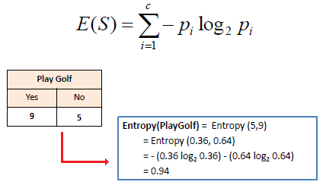
Entropy
The entropy using the frequency table of one attribute:
Hints: Excel=log(value, 2)

Slide 34
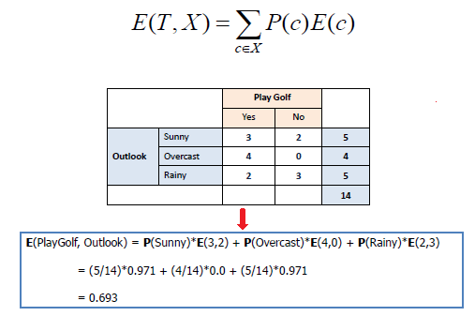
Entropy
Entropy using the frequency table of two attributes:

Slide 35
Information Gain
ID3 uses information gain as its attribute selection measure.
Constructing a decision tree is all about finding attribute that returns the highest information gain (i.e., the most homogeneous branches).

Slide 36
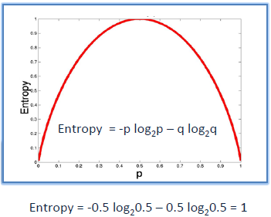

Step 1: Calculate the entropy

Slide 37
Step 2: Calculate the Information Gain
The dataset is then split on the different attributes.
The entropy for each branch is calculated. Then it is added proportionally, to get total entropy for the split.
The resulting entropy is subtracted from the entropy before the split. The result is the Information Gain, or decrease in entropy.
Formula for Information Gain:

Slide 38
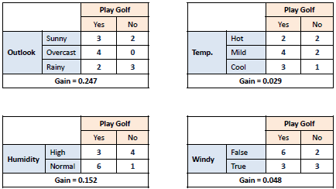

Step 2 Conti

Slide 39
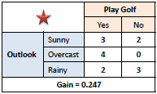
Step 3:
Choose attribute with the largest information gain as the decision node.

Slide 40
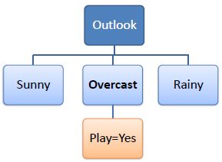
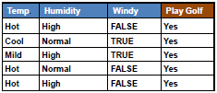
Step 4a:
A branch with entropy of 0 is a leaf node.

Slide 41
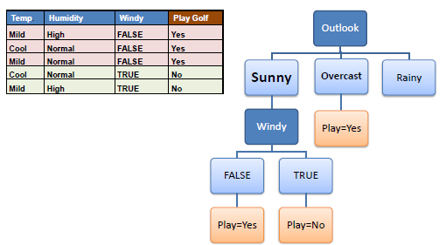
Step 4b:
A branch with entropy more than 0 needs further splitting.

Slide 42
Step 5:
The ID3 algorithm is run recursively on the non-leaf branches, until all data is classified.

Slide 43
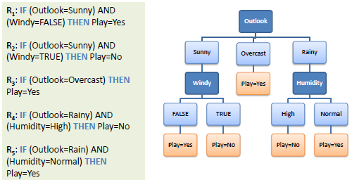
Decision Tree to Decision Rules
A decision tree can easily be transformed to a set of rules by mapping from the root node to the leaf nodes one by one.

Slide 44
References
http://www.saedsayad.com/decision_tree.htm

